Slide 1
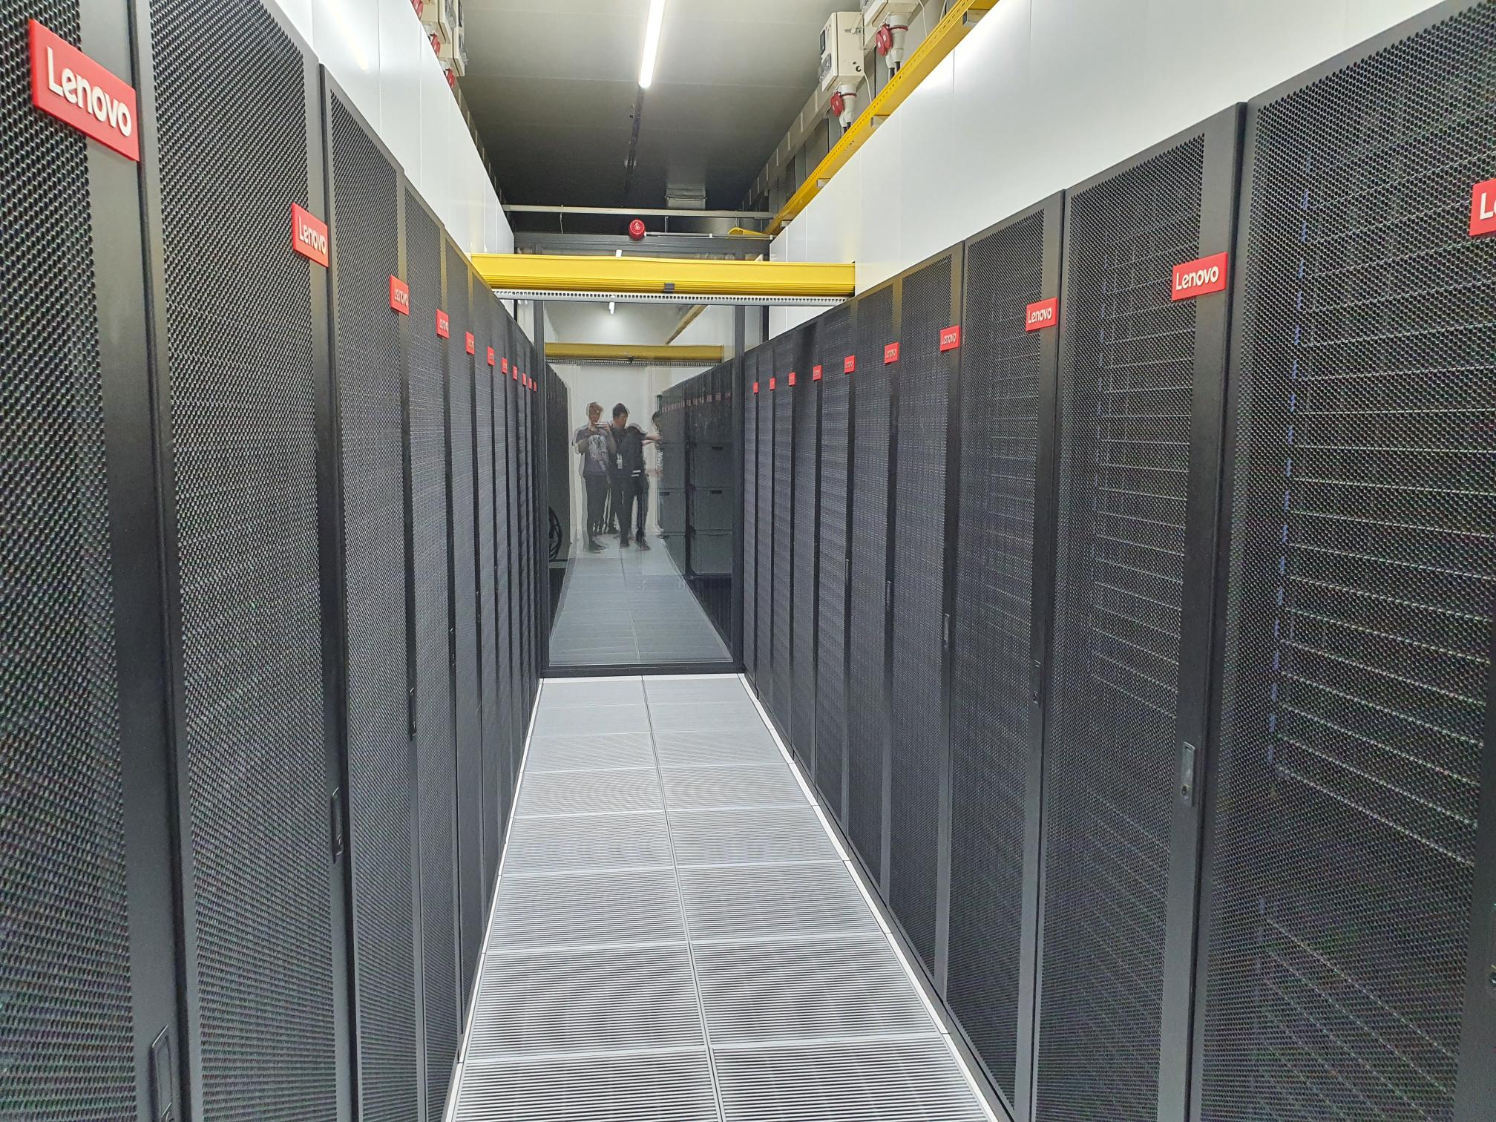

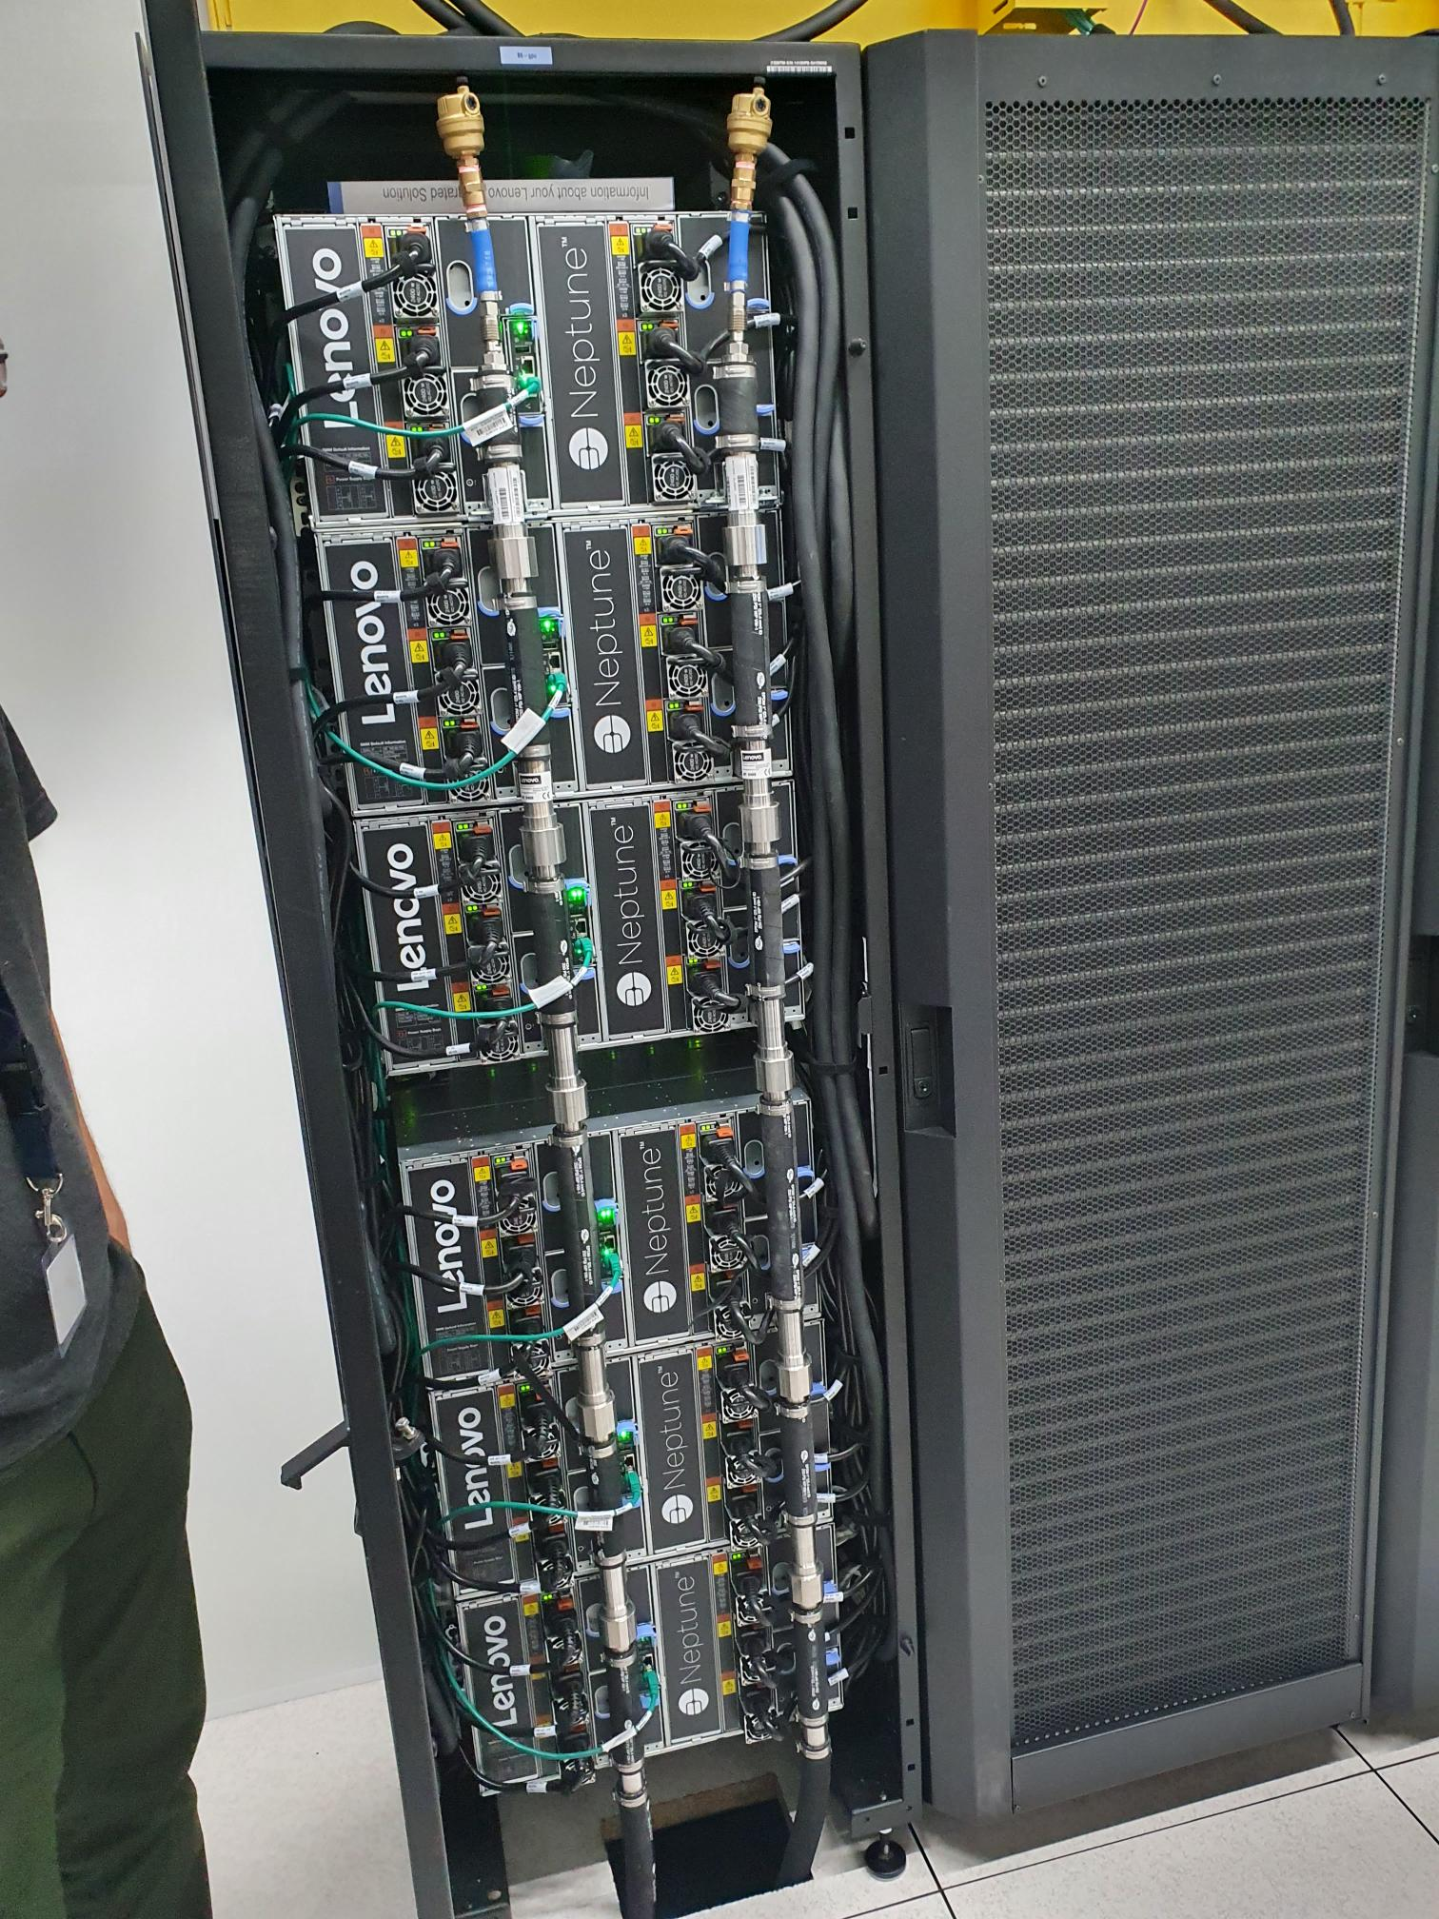
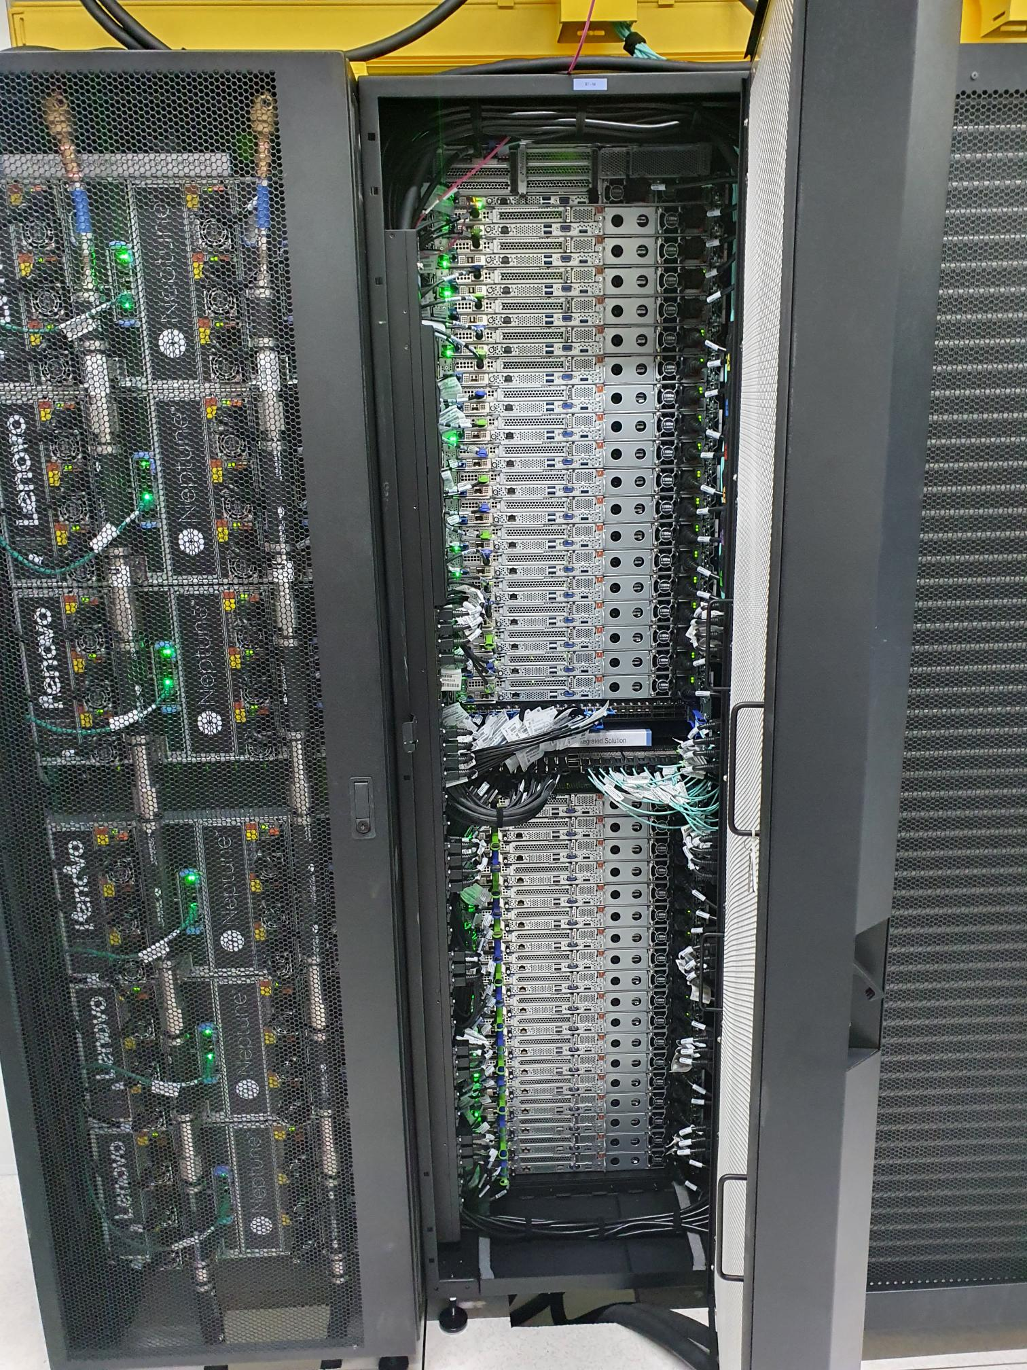

High-Performance Machine-Learning
Robert Jan Schlimbach
Team High-Performance Machine-Learning

Slide 2

Chapter orange
Monitoring!

Slide 3
Monitoring pyramid
Kernel-level profiling
Nsight compute
Job-level Profiling
PyTorch profiler, nsight systems
Time investment
Performance metric collection
Wandb, Tensorboard perf metric logging (e.g. iterations per second, %watts over time)
Runtime monitoring
Htop, nvtop, nvidia-smi, dcgmi

Slide 4
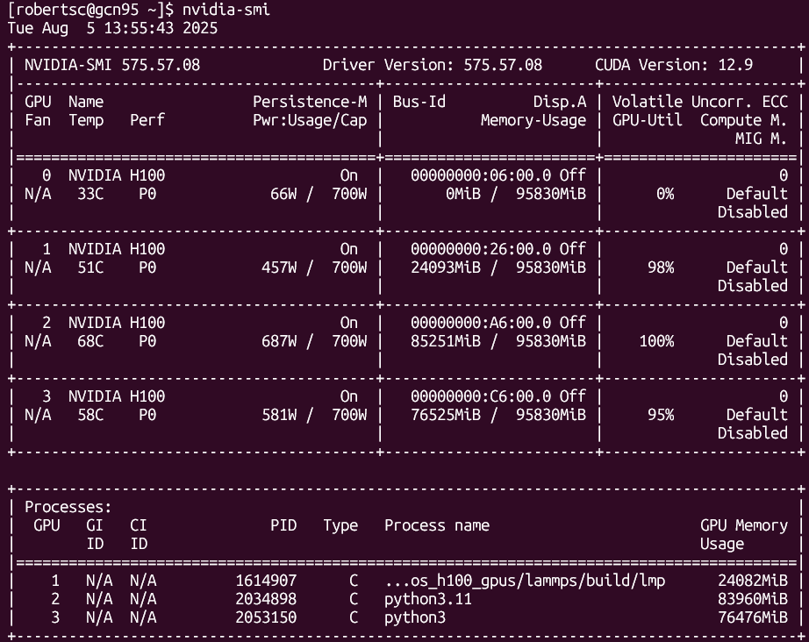
nvidia-smi

Slide 5
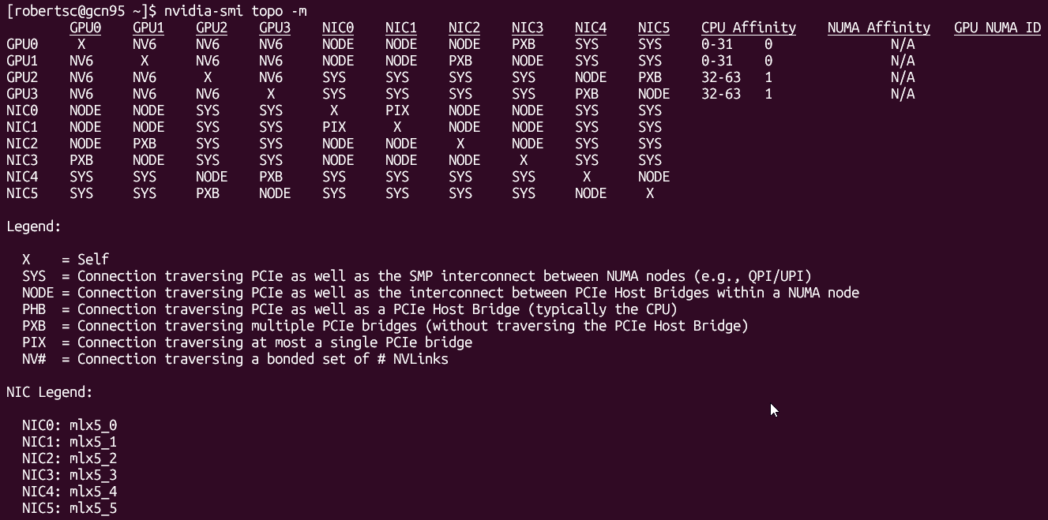
nvidia-smi

Slide 6
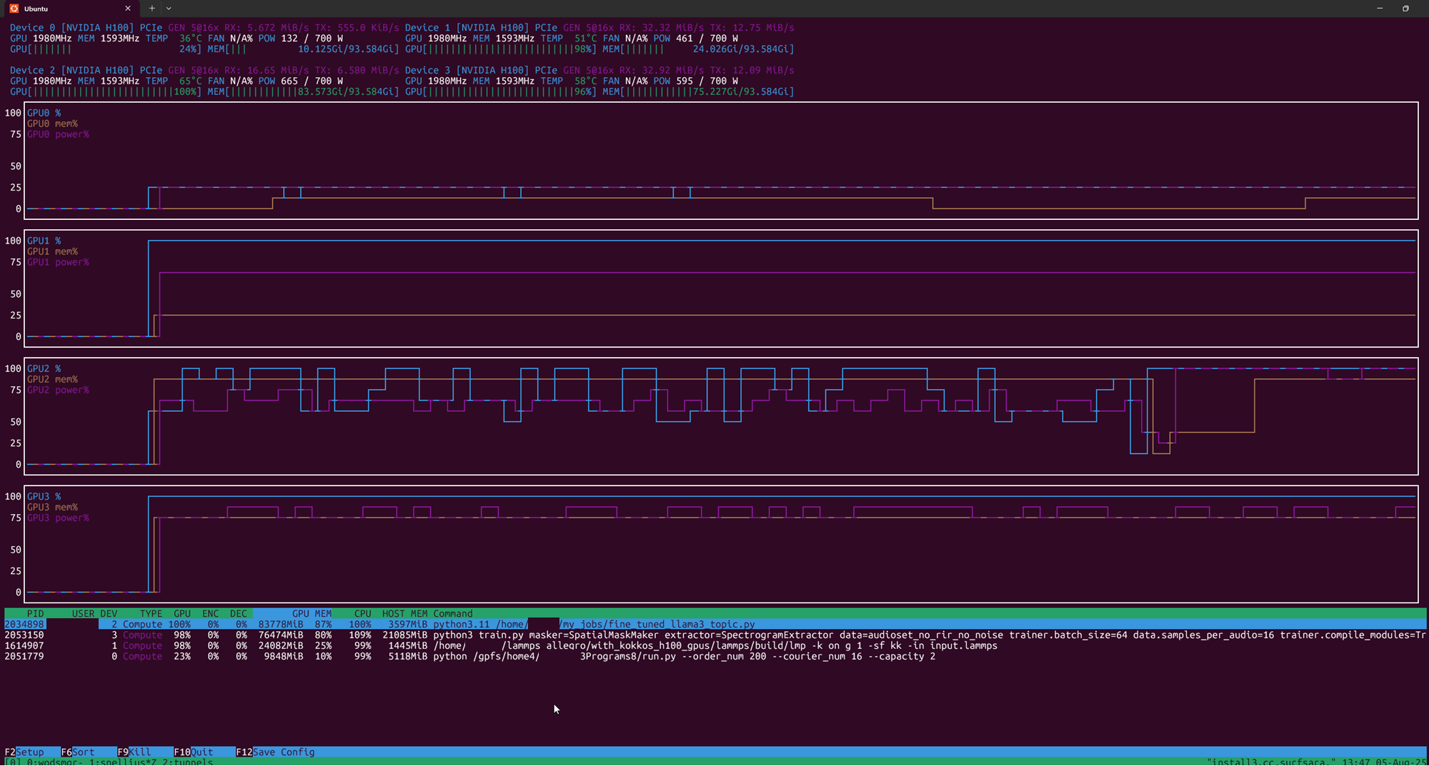
nvtop

Slide 7
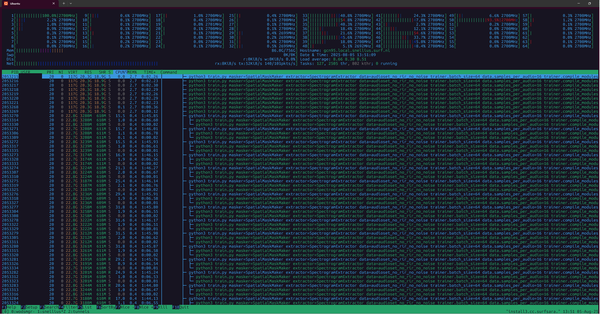
htop

Slide 8
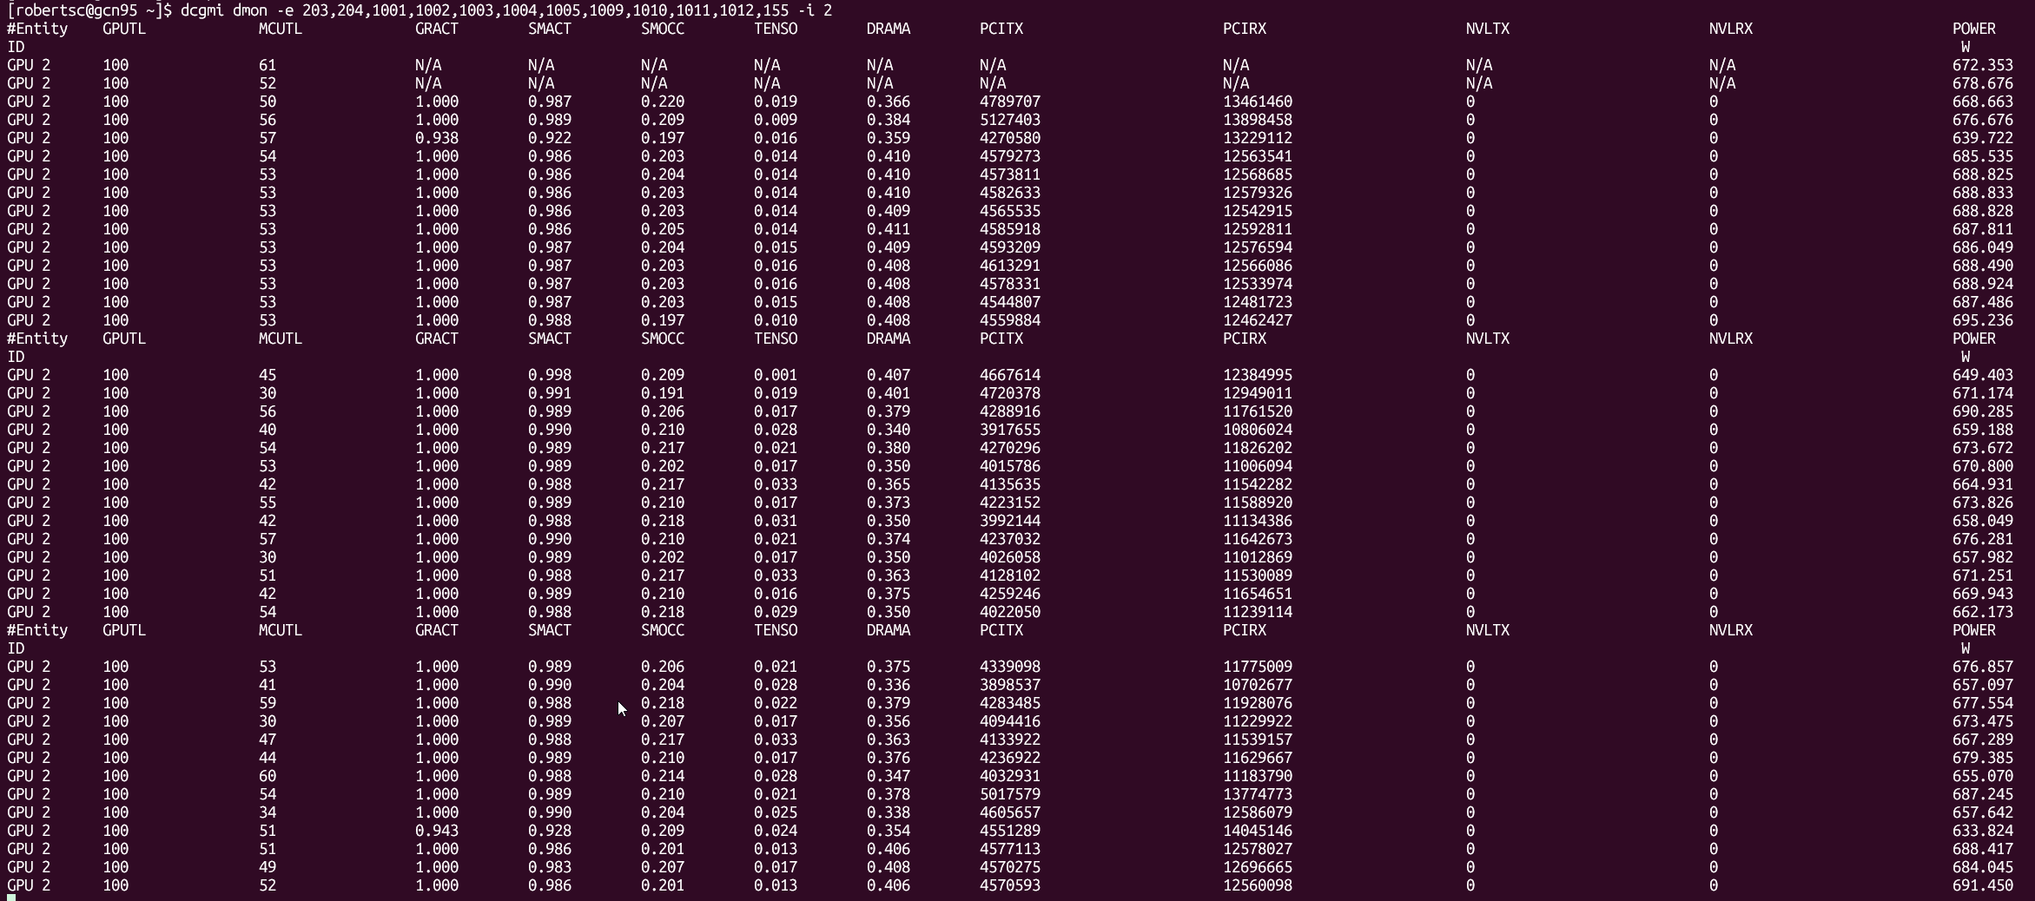
dcgmi

Slide 9
Chapter orange
Profiling

Slide 10

Rapidfire: implementation details
Some useful resources:
https://pytorch.org/docs/stable/notes/cuda.html
https://docs.nvidia.com/deeplearning/performance/dl-performance-memory-limited/index.html
https://docs.nvidia.com/deeplearning/performance/index.html
Duncan: "You can take any piece of code, spend 6 months optimizing it, and then write a paper about it"

Slide 11
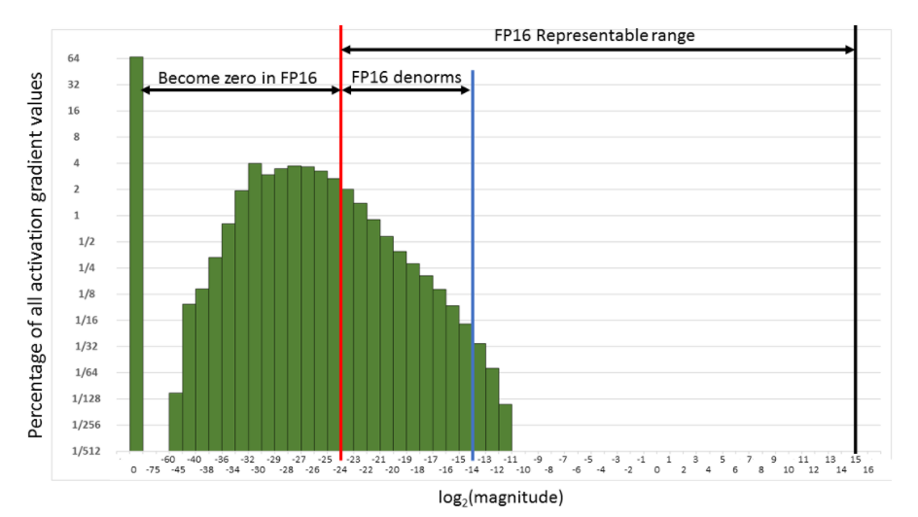
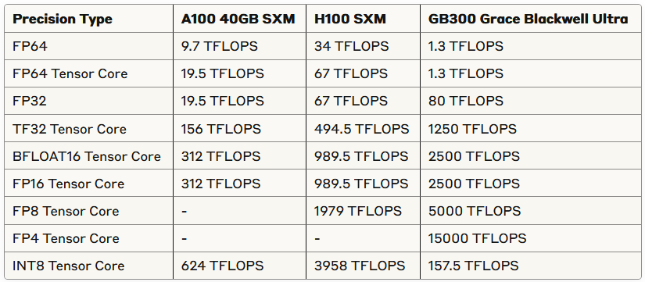
Level 0: "oh my god": torch.amp
If pytorch mixed precision isn’t working, probably you are doing something wrong
Gives you a free 2x+ speed boost
FP16 is probably better, BF16 is easier
FP8 is coming

Slide 12
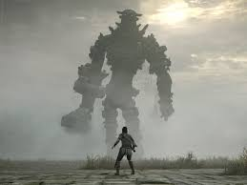
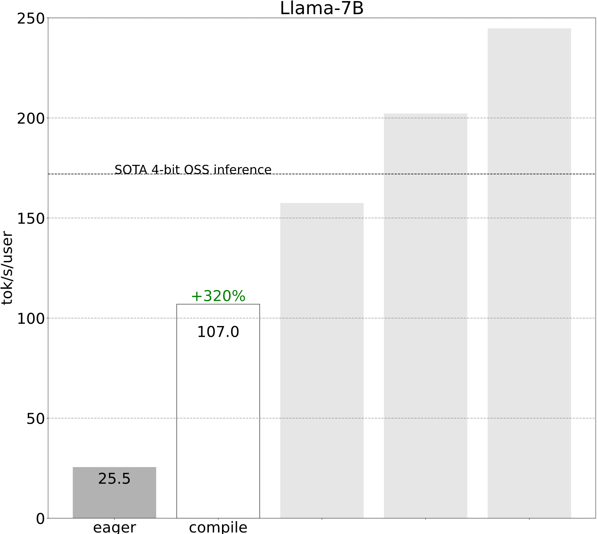
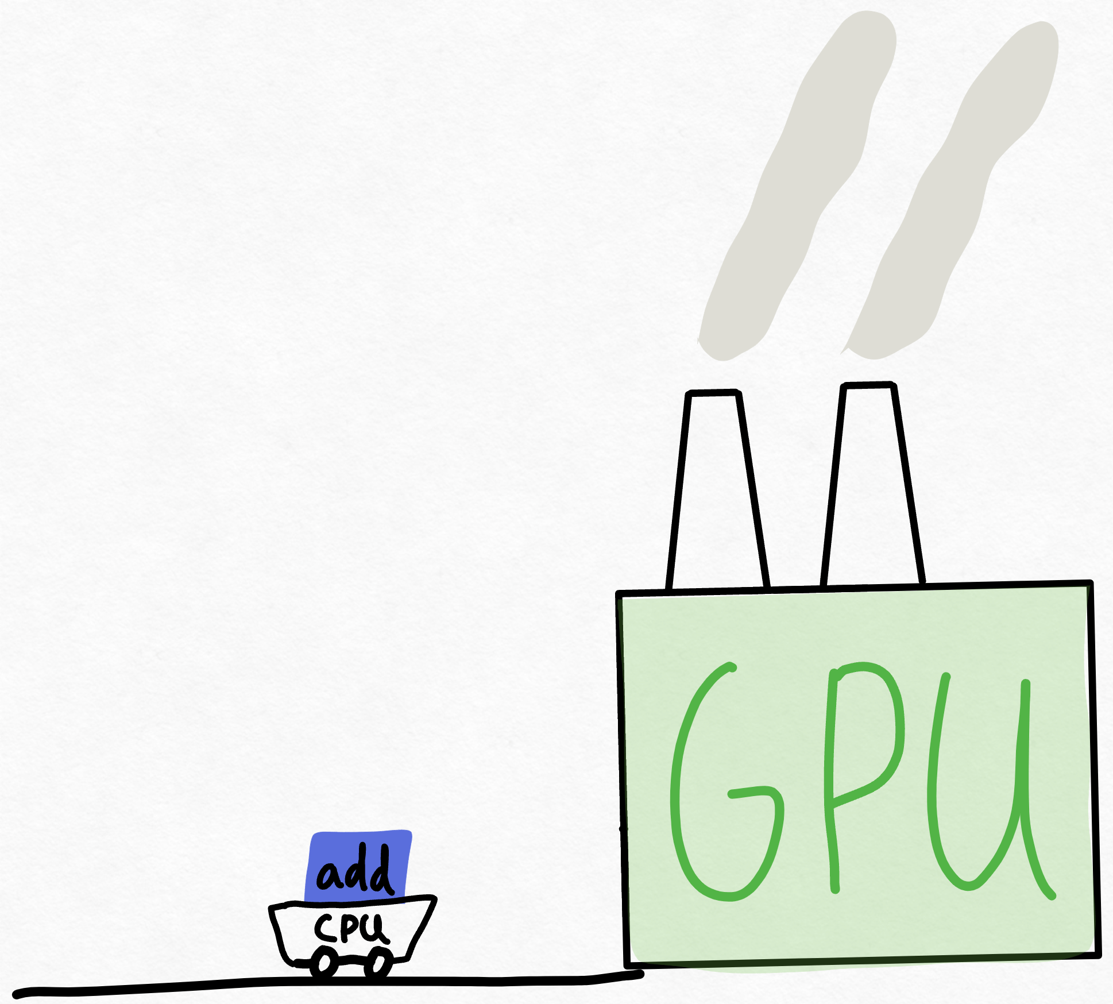
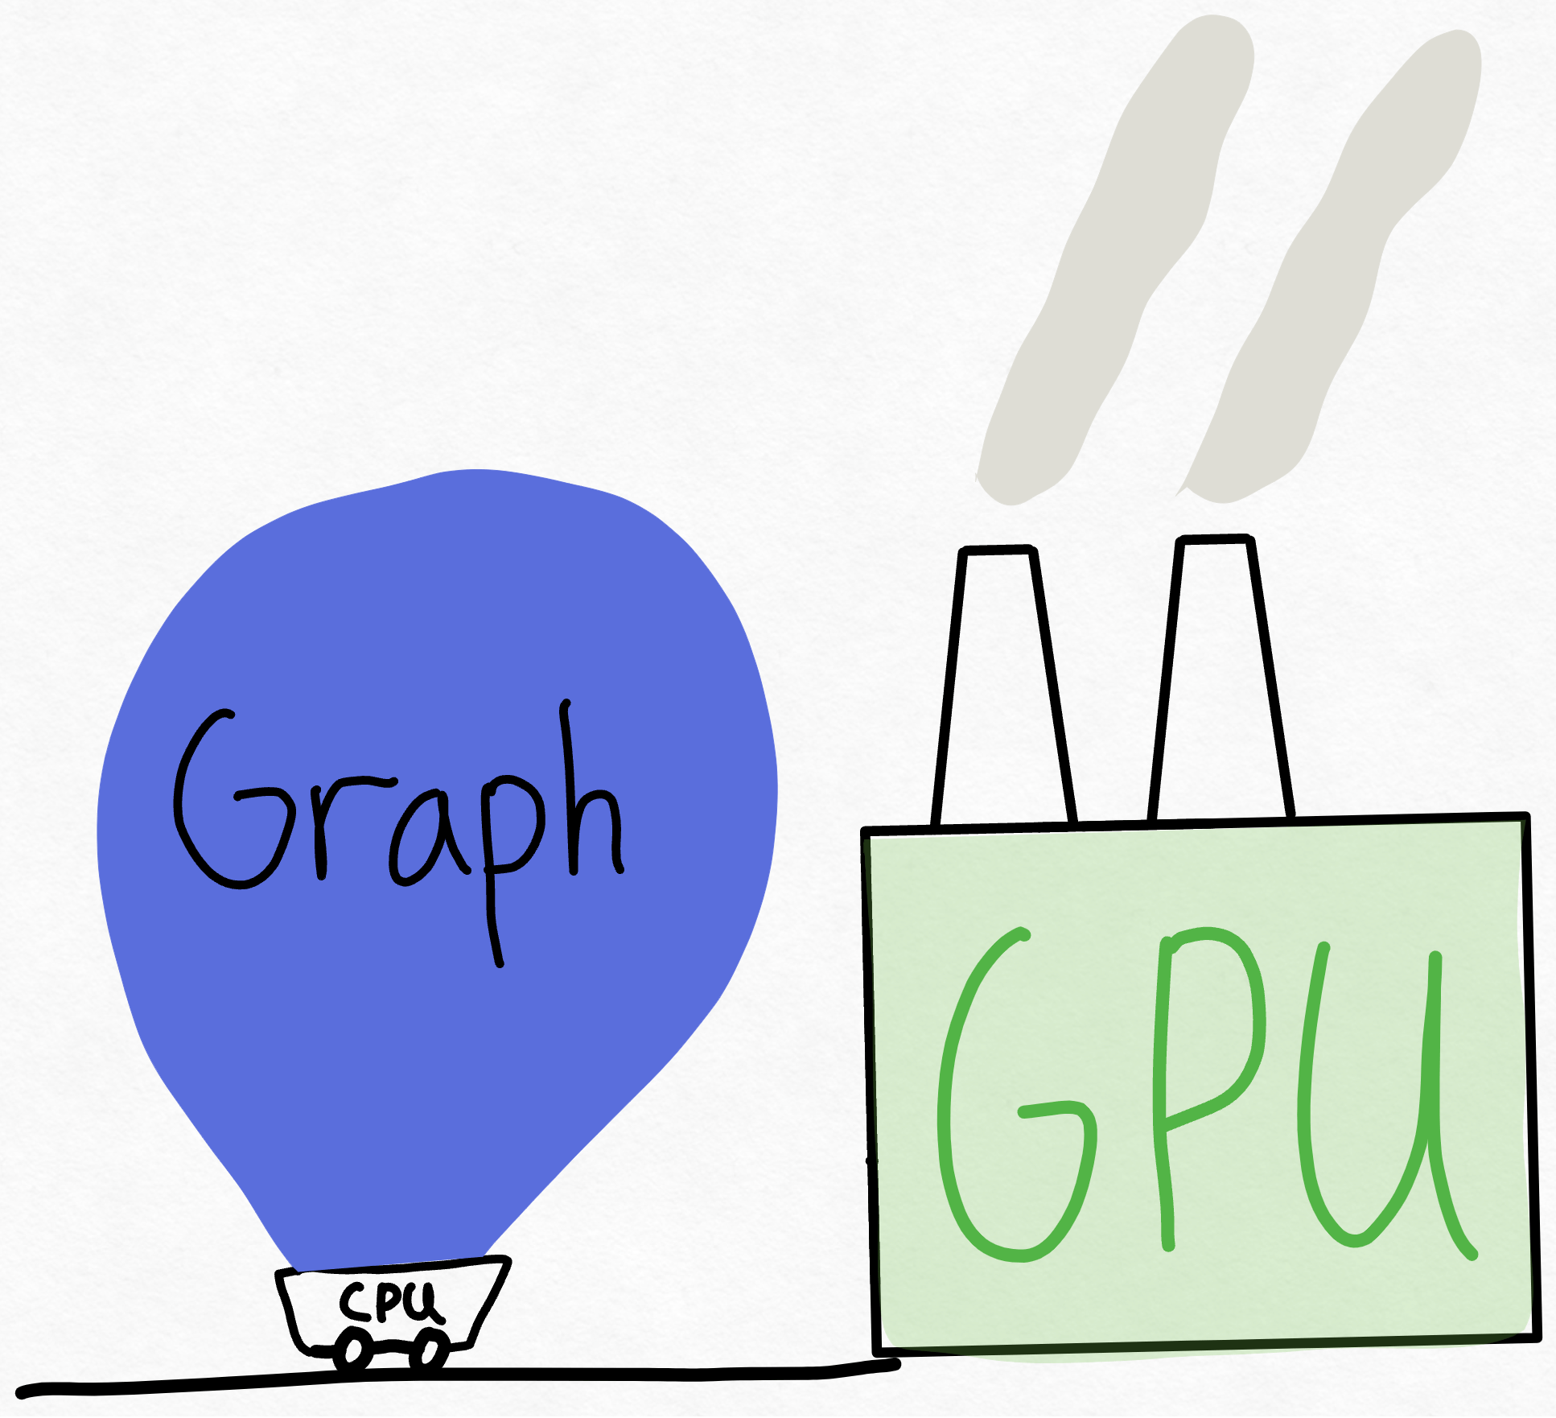
Level 0: "oh my god": torch.compile
1 CPU core is pinned to 1 GPU (used to be worse)
CPU cannot keep up with the giant that is the GPU
Still (somewhat) need to know the magic incantation:

Slide 13


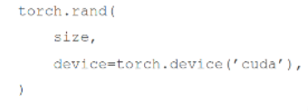
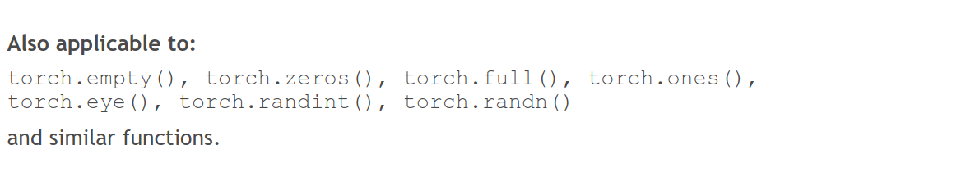
Level 1: Shouldn't impact model convergence:
Avoid CPU-GPU sync
Create tensors directly on the device
✅

Slide 14
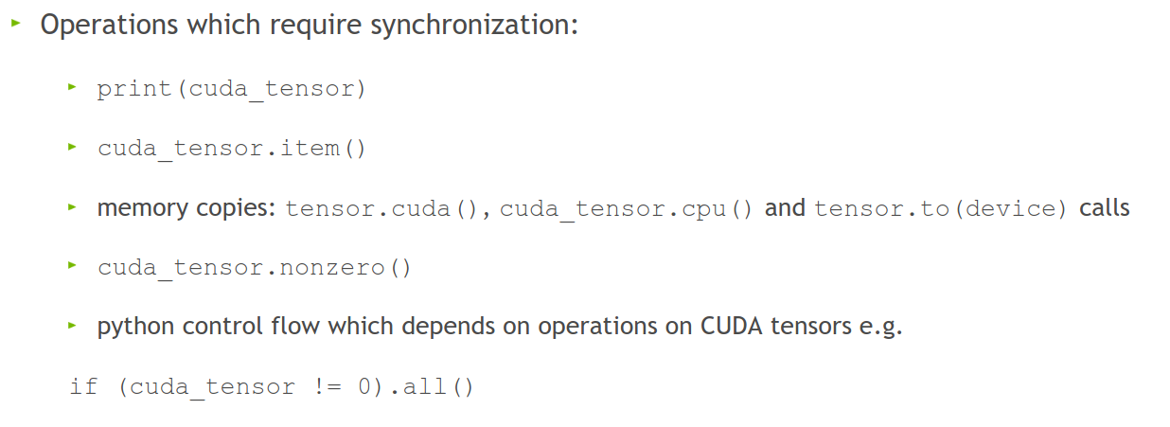
Level 1: Shouldn't impact model convergence:
Avoid doing these inside a training loop if possible:
This forces PyTorch to copy data from GPU to CPU, slowing performance.

Slide 15

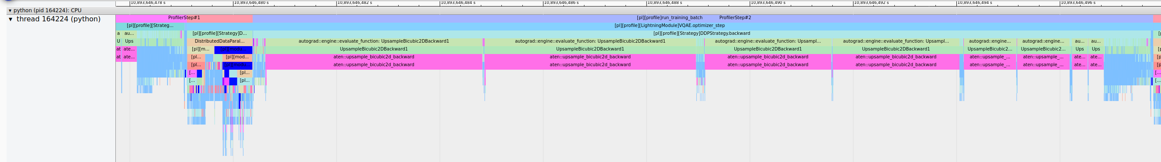
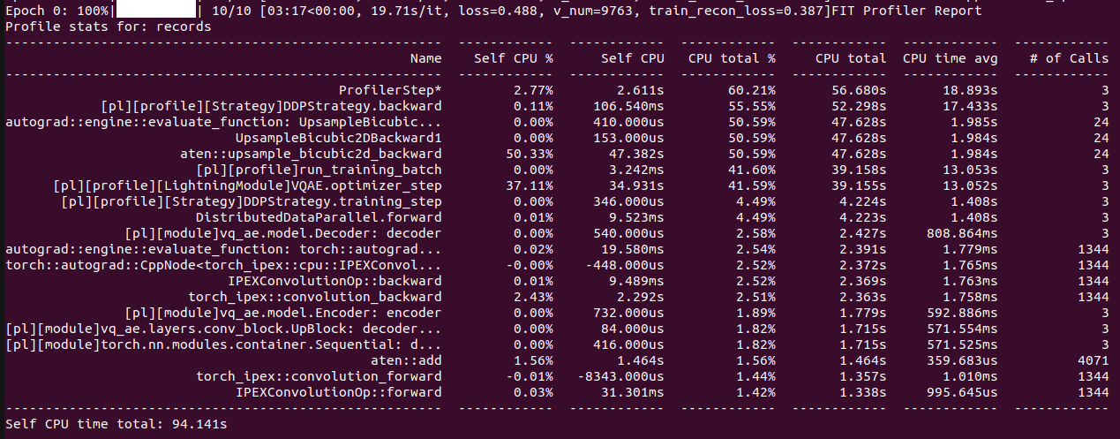
Or: Change your model
Worst case scenario:

Slide 16
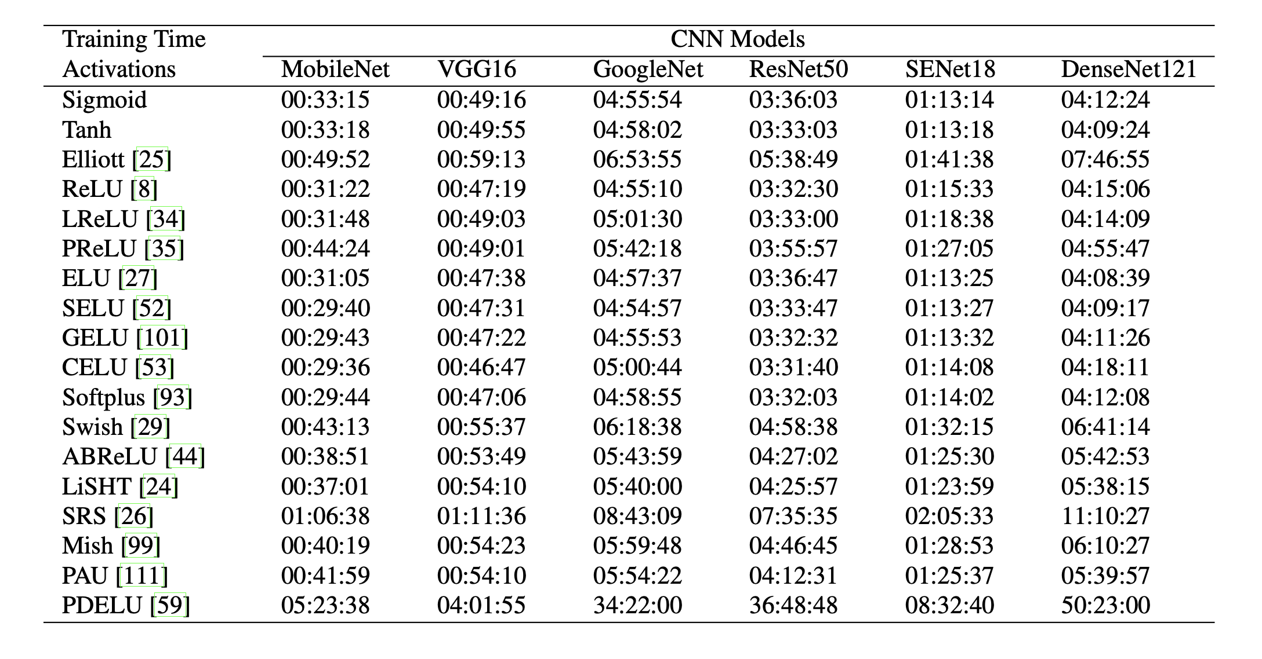
Or: Change your model
Change model architecture to improve performance characteristics, e.g.:
Use LoRA for fine-tuning
Use pre-trained model aka zero shot (@train VAE for latent space creation or use pre-trained model)
E.g. Llama, DINOv2
Incorporate dataloading operations into the model instead of CPU pipeline
ViT vs CNN vs GNN
Change non-linearities
Multiples of 2,8,1024
Channels
Hidden size
Vocab size
Batch size
Input resolution/sequence length
Everything
For transformers:
Patching
Masked attention

Slide 17
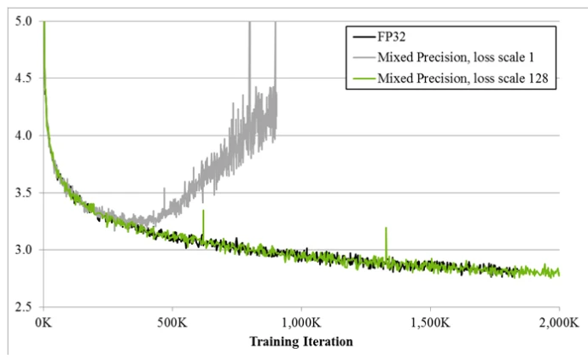
Always
Have a baseline
Check convergence statistics

Slide 18
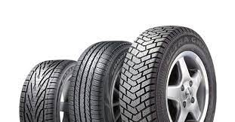
Profile
Get a grip on your model’s performance
Profile
Profile
Profile

Slide 19
Chapter orange
On that note: Profiling!

Slide 20
Profile
Notebook available at https://github.com/SURF-ML/HPML-course-materials/blob/august2025/Day2/notebooks/PyTorch_profiling.ipynb
Reference traces are in https://github.com/SURF-ML/HPML-course-materials/tree/2025-11/hands-on/profiling/logs
``` python3 -m venv venv source venv/bin/activate pip install git+https://github.com/pytorch/kineto.git#subdirectory=tb_plugin git clone --depth=1 https://github.com/SURF-ML/HPML-course-materials.git tensorboard --logdir HPML-course-materials/hands-on/profiling/logs ```

